Slide 1
Implementation of Keylogger
- Rohith Yamsani
- Dinaker Reddy Kesireddy
- Sathwik Reddy Nandikonda

Slide 2
What is keylogger
Action of secretly recording the keys pressed on a keyboard such that the person using it is unaware that their actions are being watched
The information is then accessible to the person running the logging software
Used to monitor activity of Users such as Username, Passwords and other sensitive data.

Slide 3
Different types of keyloggers
Hardware-Based Keyloggers:
Typical Hardware Keylogger is a hardware circuit that is installed anywhere between the computer keyboard and the computer for keystroke logging.
Hardware-based keyloggers do not require the installation of any software because they operate at the hardware level of a computer system.
Hardware Keyloggers usually have built in memory
Operates at the hardware level, so it is undetectable to anti-virus softwares

Slide 4
Different types of keyloggers
Software-Based Keyloggers:
The software can capture anything that has been copied to the clipboard, graphics-based information, screenshots are taken.
Can store data on local computer or in a cloud.
Can continue to operate indefinitely while the information is being transmitted.

Slide 5
Uses of Keylogger
Monitoring employee activity
Recovering the lost data
Cyber
security
Law enforcement
Notes:
Monitoring employee activity: Employers can use keyloggers to monitor their employees' activity on company computers to ensure that they are using the devices appropriately and not engaging in unauthorized or illegal activities.
Recovering lost data: Keyloggers can be used to recover lost or deleted information by capturing keystrokes as they are typed. This can be especially helpful in situations where important data has been accidentally deleted or lost due to a computer malfunction.
Law enforcement: Law enforcement agencies can use keyloggers as part of their investigations to gather evidence of criminal activity, such as hacking or identity theft.
Cybersecurity: Keyloggers can be used by cybersecurity professionals to detect and prevent cyber attacks, by monitoring for unusual activity on a computer or network.

Slide 6
Features of our Keylogger:
Keystroke monitoring in Text Editors
Search Result in Windows/Web Browsers:
Applications opened
Websites visited

Slide 7
Advanced Features of Key logger
ScreenShots Captured
Automatically clearing log data
Cut, Copy and Paste Information
Track documents and folder information

Slide 8
Keylogger.py
Execute
Saved to log.txt

Slide 9
How to implement keylogger
A malware attached to the useful files at first glance seems to be helpful to the victim.
Once the victim downloads and installs the malicious program, it performs keylogging.
Tracking of every keystroke entered on the computer, the names of the currently running applications and websites viewed are stored in a file by the key loggers.
By this program, we will be to record and document the keystrokes that were entered by the victim into a .txt file
Works only in windows operating system.

Slide 10
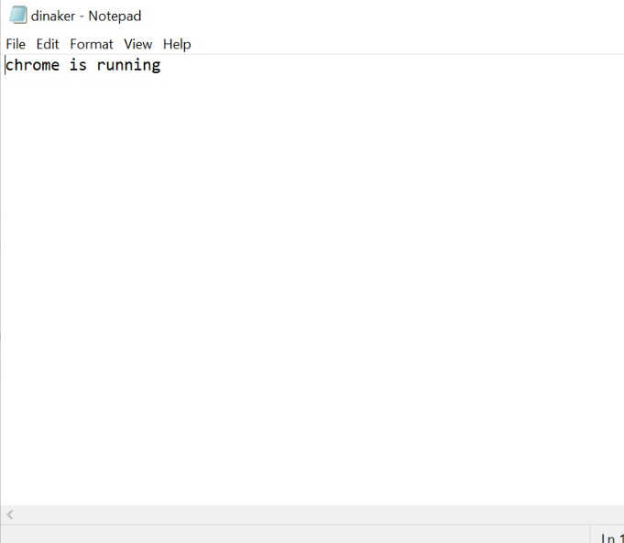
Applications Visited
Names of the currently running applications and websites viewed are stored in a file

Slide 11
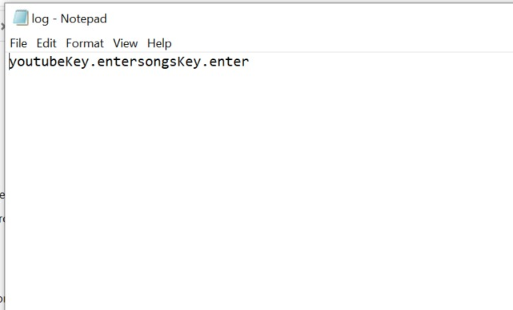
Keystroke monitoring:
Every keystroke we entered in the keyboard is saved to log text file

Slide 12
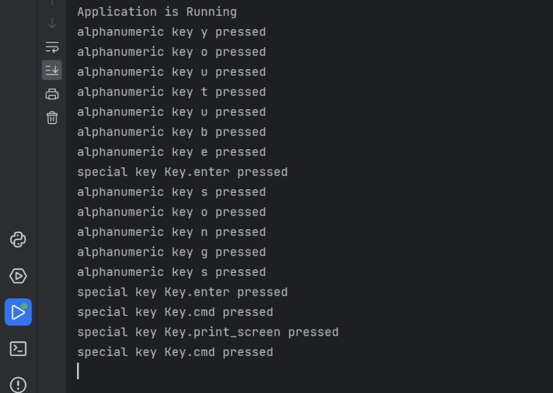
Output:

Slide 13
How to detect keylogger
We can use good antivirus/anti-malware scanners to detect and remove keyloggers.
Keyloggers of poorer quality might reveal themselves in a number of ways. There could be a slowdown in performance of the system, we can see distinct lag in the mouse movement, or the screen doesn't display what you are actually entering.
The best way to detect keyloggers is by scanning the system regularly with a quality cybersecurity programs.
Good cybersecurity tools first discover the malware, then eliminate it using heuristic analysis, signature detection, and identification of typical keylogger behavior related to keystroke and screenshot recording.
Using On-Screen Keyboard instead of Physical Keyboard.

Slide 14
Thank You
THANK YOU

